Slide 1
Anxiety Severity Prediction Analysis
Name: G. Bhavana
Roll No: 2211CS010686
Section : S3 (88)
Dataset: Anxiety Attack Dataset (Kaggle)

Slide 2
Introduction
This project focuses on predicting the severity of anxiety levels using PySpark for large-scale data processing and machine learning.
The dataset contains demographic and behavioral attributes such as Age, Gender, Occupation, Sleep patterns, Physical Activity, and Symptoms.
The main objective is to analyze anxiety-related factors and build a prediction model that classifies individuals into different severity levels (Mild, Moderate, Severe).

Slide 3
Initial Analysis of the Dataset
1.Dataset Size
The dataset contains 12,000 records and 20 columns.
Loaded successfully using spark.read.csv() with inferSchema=True.
2.Key Columns
Numerical Columns: Age, Sleep Hours, Physical Activity, Caffeine Intake, Alcohol Consumption, Stress Level, Heart Rate, Breathing Rate, Sweating Level, Therapy Sessions, Diet Quality, Severity of Anxiety Attack (target).
Categorical Columns: Gender, Occupation, Smoking, Family History of Anxiety, Dizziness, Medication, Recent Major Life Event.
Target Variable: Severity of Anxiety Attack (1–10) (can be categorized as Mild, Moderate, Severe).

Slide 4
3.Missing Values
No missing data detected (0%).
Dataset is clean and complete, no imputation required.
4.Duplicate Records
No duplicate IDs or rows found.
5. Outliers
Slight variations in Sleep Hours and Alcohol/Caffeine intake.
Retained, as they represent genuine real-world behavior.

Slide 5
Dataset Observations
1. General Observations
The Dataset is large, clean, and balanced.
Each record provides demographic, lifestyle, and physiological factors that affect anxiety.
2.Numerical Insights
Average Sleep Hours: ~6.48 hrs/day.
Average Stress Level: ~5.5/10.
Severity categories: Mild (29.4%), Moderate (30.7%), Severe (39.9%).

Slide 6
3. Categorical Insights
Gender: Female (48%), Male (48%), Other (4%) — severity is slightly higher in Male/Other groups.
Occupation: Top groups include Unemployed, Doctor, Teacher, Engineer. Mean severity ~5.4–5.6.
Smoking, Alcohol, Caffeine: lifestyle habits show weak but noticeable influence.
4. Behavioral & Regional Trends
Higher severity often linked with stress, poor diet, smoking, and alcohol.
Family history of anxiety correlates with higher severity.

Slide 7
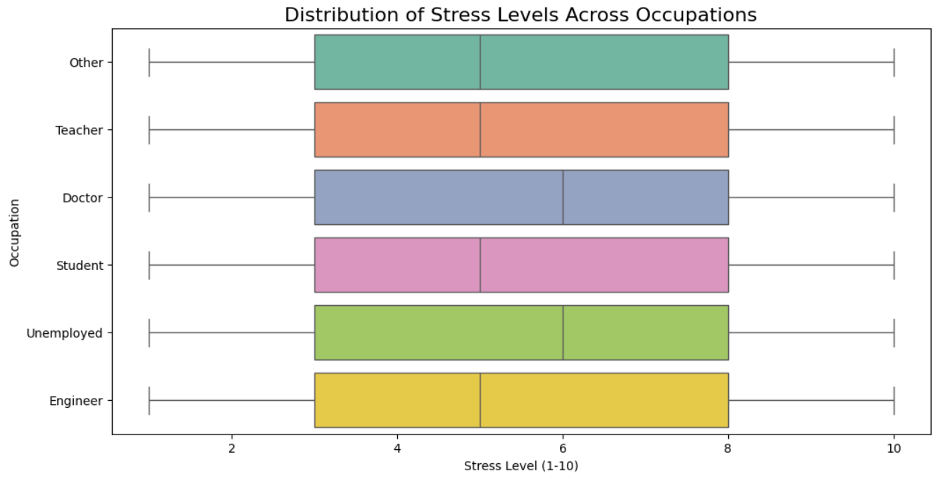
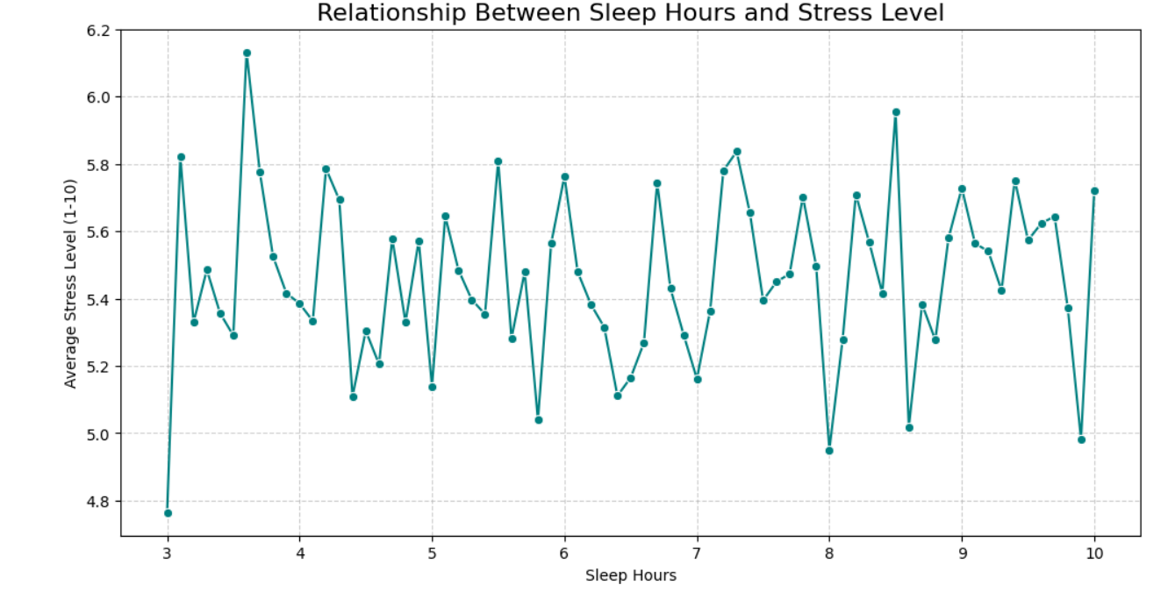
Graphs
1. Box Plot (Distribution of Stress Levels Across Occupations)
2. Line Plot (Sleep Hours Vs Stress Level)
Purpose: To compare stress levels across occupations and highlight variations and outliers.
Observation: Some occupations have higher median stress, while others show more variability in stress levels.
Purpose: To examine how average stress levels change with different amounts of sleep.
Observation: Average stress level generally decreases as sleep hours increase, indicating more sleep is linked to lower stress.

Slide 8
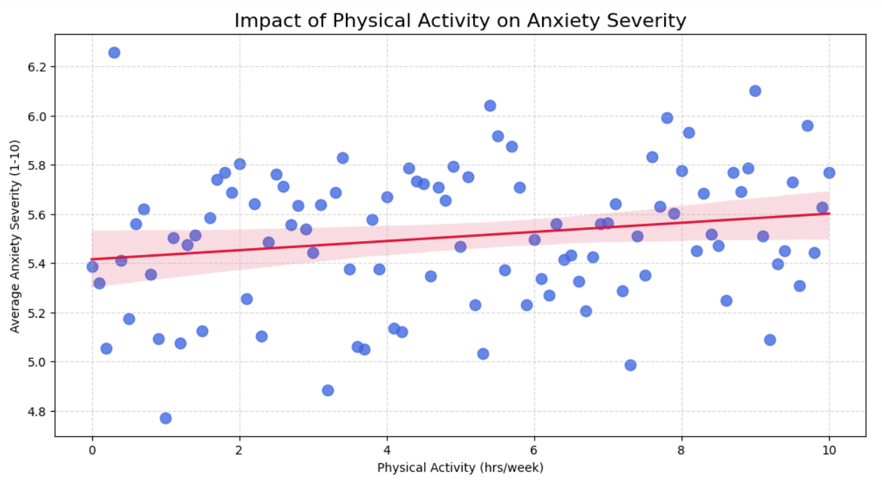
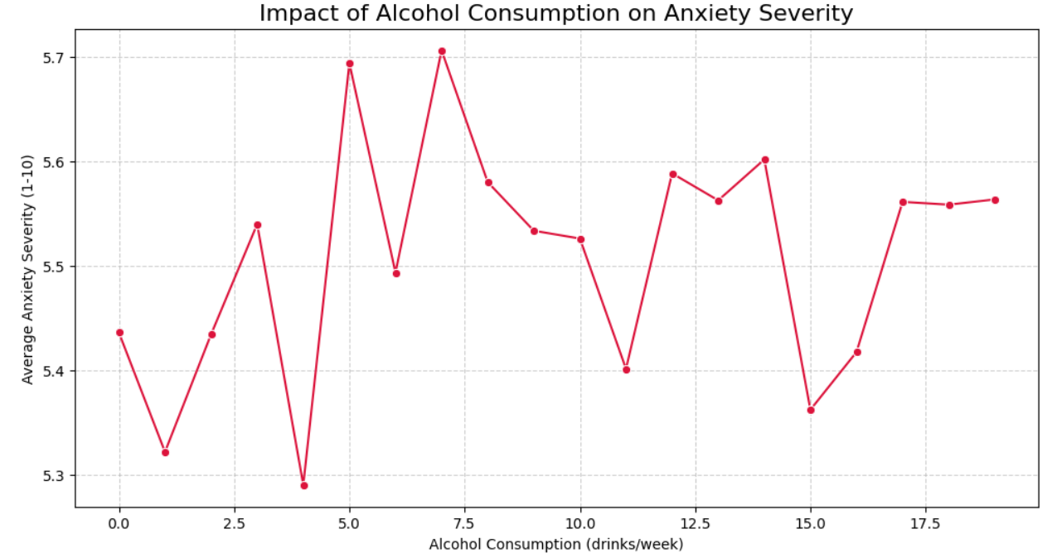
3. Scatter Plot (Physical Activity Vs Severity)
4. Line plot (Alcohol Intake Vs Severity)
Purpose: To examine how weekly physical activity relates to the average severity of anxiety attacks.
Observation: Higher physical activity is associated with lower average anxiety severity.
Purpose: To show the relationship between alcohol consumption and average anxiety severity.
Observation: Higher alcohol consumption is associated with increased average anxiety severity.

Slide 9
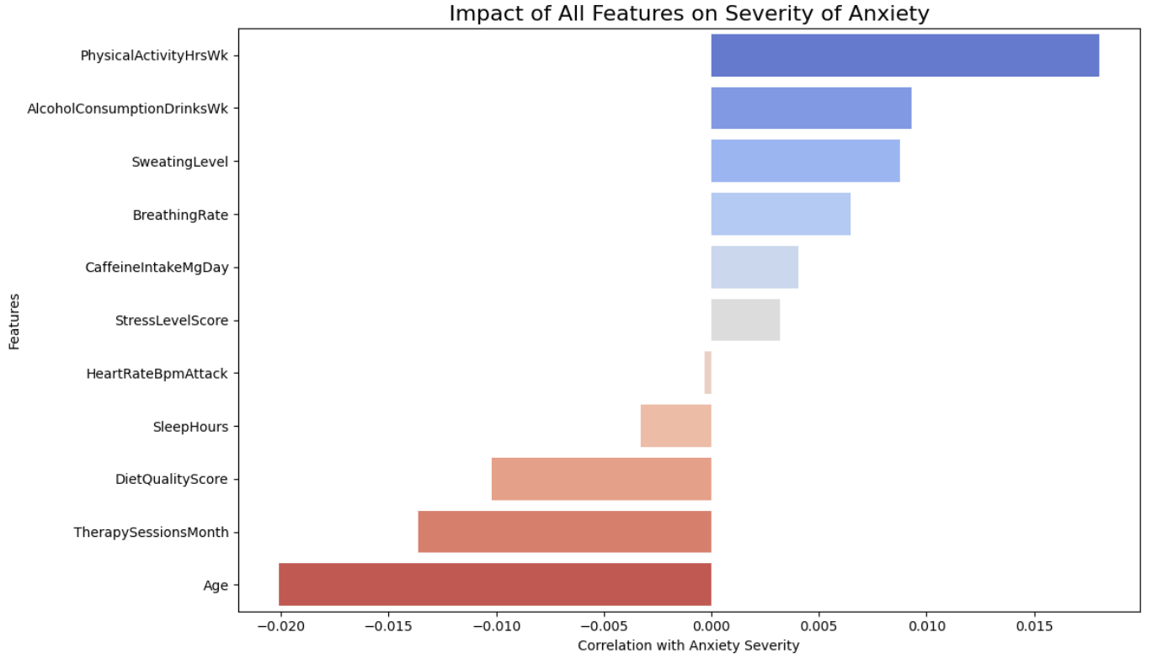
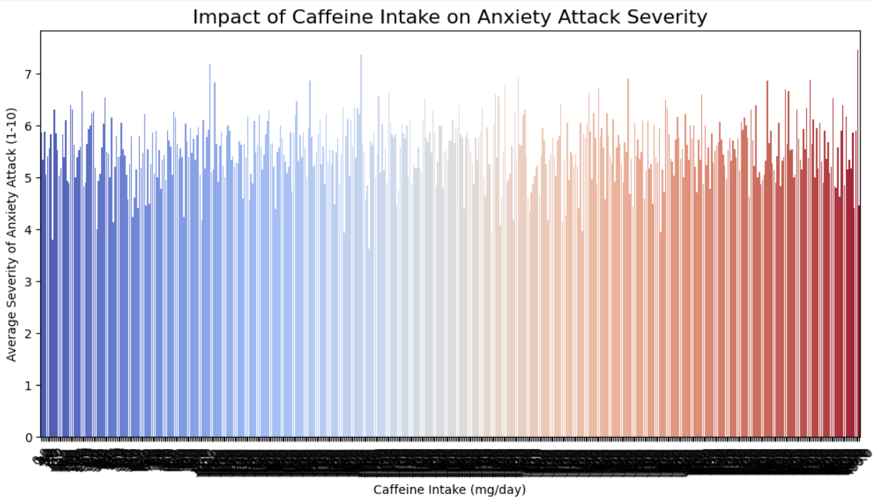
5. Bar Plot (Feature Correlation with Anxiety)
Purpose: To visualize how strongly each feature is correlated with anxiety severity.
Observation: Features at the top have the highest positive or negative correlation with anxiety severity, indicating stronger influence.
6. Bar Plot (Caffeine Intake vs Anxiety Severity)
Purpose: To show how daily caffeine intake affects average anxiety attack severity.
Observation: Higher caffeine intake is associated with increased average anxiety severity.

Slide 10
Conclusion
Dataset Insights: The analysis provided valuable insights into factors affecting anxiety severity.
Severity Distribution: Mild (29%), Moderate (31%), Severe (40%).
Key Influences: Stress levels, lifestyle habits (sleep, physical activity, caffeine, alcohol), and family history significantly impact anxiety severity.
Demographics: Severity is fairly consistent across gender and occupation, with minor variations.
Lifestyle Impact: More sleep and higher physical activity are linked to lower anxiety, while higher caffeine and alcohol intake are associated with increased severity.
Future Scope
Predictive Modeling: Build and evaluate classifiers (RandomForest, GBT, Logistic Regression) on severity classes.
Segmentation: Cluster individuals based on lifestyle/medical factors for targeted insights.
Personalized Recommendations: Suggest lifestyle/diet/therapy changes to lower severity
Time-Series Analysis: Track anxiety patterns over weeks/months for prevention-focused strategies.

